Slide 1
Welcome To York Code Dojo
David Betteridge @da_betteridge
Yorkdevelopers.org
@yorkdevelopers
@yorkcodedojo

Slide 2
Agenda
Quick Introduction
Explain the problem
Work in pairs till 8.45pm
Opportunity to show off solutions
Pub about 9pm

Slide 3

Code Dojo
Notes:
Who has been to a code dojo before?
What is the point?
It’s a place to practice coding safely. By that we mean it doesn’t matter if you haven’t solved the problem by the end of the evening. No one will judge you on it. It’s a place to practice, learn and try out new things.
For example you could use a language you have never used before, partner with someone new, try a different approach to solving the problem. You could add your own constraints; like my functions won’t have more than three lines; or I’m not going to use any IF statements.
(It’s also meant to be fun) It’s driving a car to work every day, you might cover a lot of miles, but if you are doing the same journey then does your driving ability really improve?
It’s driving a car to work every day, you might cover a lot of miles, but if you are doing the same journey then does your driving ability really improve?

Slide 4
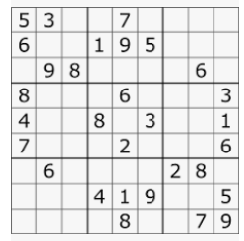
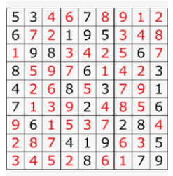
Tonight – Sudoku Solver
Notes:
Start with a partly populated grid
Fill in missing digits 1-9
Three rules
Each row must contain 1-9
Each column must contain 1-9
Each of the 9 subgrids must contain 1-9
There should only be one solution

Slide 5
Techniques
Brute Force (i.e. Guess)
Use Logic

Slide 6
Logic
Useful website - https://www.sudokuoftheday.com/techniques/
Notes:
Show Swagger
Show C# Example

Slide 7
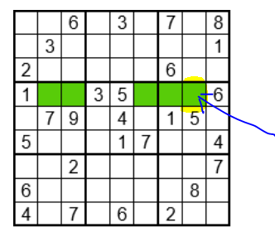
Single Position (7)
Notes:
The only place that 7 can go in that row.
Show other sevens

Slide 8
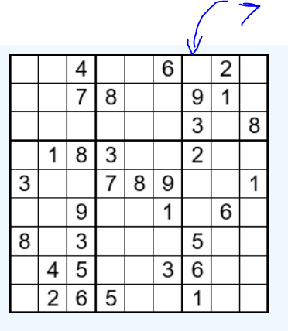
Single Candidate
Notes:
The only number which can go in that cell is a 7. Could 1 no, 2 no etc

Slide 9

More Advanced Techniques
Notes:
Those methods will allow you to solve easy boards.
You won’t have time to do the rest!

Slide 10
Ideas for getting started
See github for a simple sample board.
Write a function to check a completed board is valid
Try completing a board with just one number missing
Implement code for with the Single Position technique

Slide 11
GitHub
Please add your solutions to our yorkcodedojo github
Some instructions on the YorkDevelopers.org website.
Click on https://www.yorkdevelopers.org/blog/

Slide 12
York Code Dojo – 2nd Wednesday
12th December 2018 - Advent of Code Projects
9th January 2019– Interview style coding problems

Slide 13
York Developers
Code and Coffee
Agile York
Games Developers
Dot Net York

